Slide 1
Operations Research
CSC 434
Lecture 2
Oluwambo Olowe

Slide 2
Overview of Linear Programing
Linear Programming (LP) is a quantitative technique used to determine the best possible outcome in a given mathematical model, such as maximum profit, minimum cost, or optimal resource allocation, under a set of given linear constraints.
It is widely applied in operations research, computer science, economics, engineering, management science, and artificial intelligence (especially optimization in machine learning).
Linear programming comes under the allocation problem, is a problem which involves the allocation of given number of resources to the job. The objective of these problems is to optimize the total effectiveness i.e to minimize the total cost or maximize the total return.
Generally, there are three types of allocation problem;i. Linear programming problem. ii. Transportation problem. iii. Assignment problem. we shall discuss the linear programming problem only.

Slide 3
,
It is called “linear” because both:
The objective function (what we want to maximize or minimize) is linear, and
The constraints (the conditions that must be satisfied) are also linear equations or inequalities.
Programming here means planning or scheduling, not computer coding.
LP is a powerful tool used in:
Resource allocation
Production planning
Transportation and logistics
Diet formulation
Scheduling and network flow optimization

Slide 4
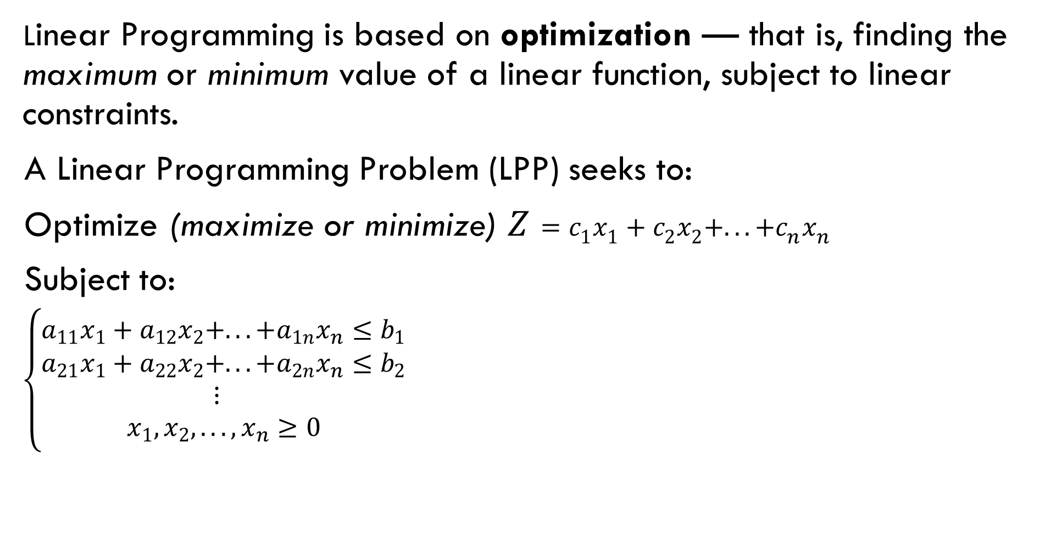
Basic Concept
Linear Programming is based on optimization — that is, finding the maximum or minimum value of a linear function, subject to linear constraints.
A Linear Programming Problem (LPP) seeks to:
$\text{Optimize}\text{ (}\text{maximize} \text{or} \text{minimize}\text{) }Z=c_{1}x_{1}+c_{2}x_{2}+...+c_{n}x_{n}$
Subject to:
$\left\{\begin{matrix}a_{11}x_{1}+a_{12}x_{2}+...+a_{1n}x_{n}≤b_{1} \\ a_{21}x_{1}+a_{22}x_{2}+...+a_{2n}x_{n}≤b_{2} \\ ⋮ \\ x_{1},x_{2},...,x_{n}≥0\end{matrix}\right.$

Slide 5
Key Terminologies
Term | Meaning
Decision Variables | The unknowns whose values are to be determined (e.g., ( x1, x2 )).
Objective Function | The function that represents the goal (maximize or minimize).
Constraints | The linear inequalities or equations that restrict the variables.
Feasible Solution | Any set of values of ( x1, x2, ..., xn ) that satisfies all constraints.
Feasible Region | The graphical area that satisfies all constraints.
Optimal Solution | The feasible solution that gives the best (maximum or minimum) value of the objective function.

Slide 6
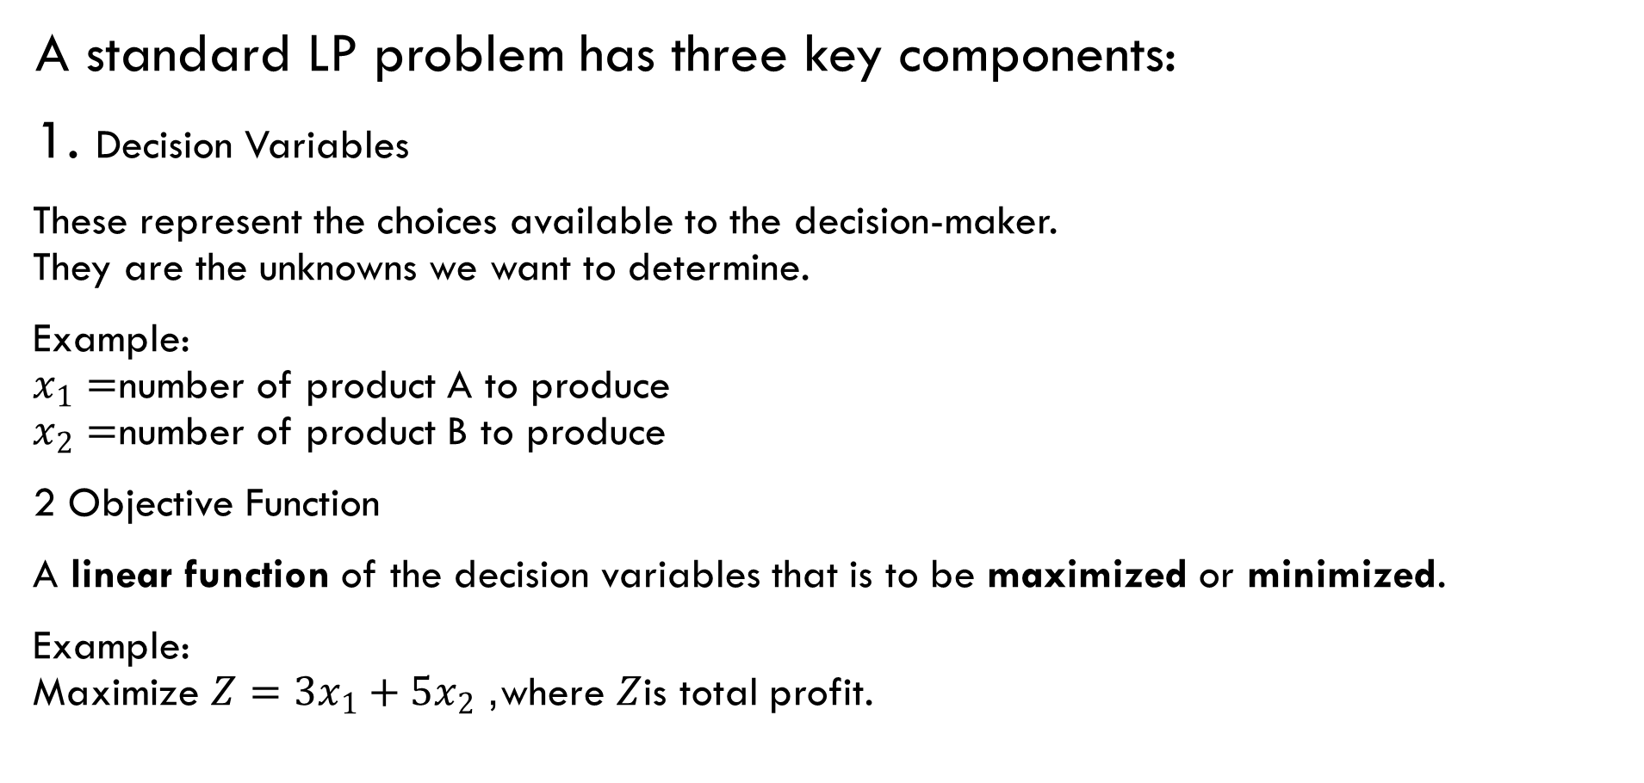
Components of a Linear Programming Problem
A standard LP problem has three key components:
1. Decision Variables
These represent the choices available to the decision-maker.
They are the unknowns we want to determine.
Example:
$x_{1}=$number of product A to produce
$x_{2}=$number of product B to produce
2 Objective Function
A linear function of the decision variables that is to be maximized or minimized.
Example:
Maximize $Z=3x_{1}+5x_{2}$, where $Z$is total profit.

Slide 7
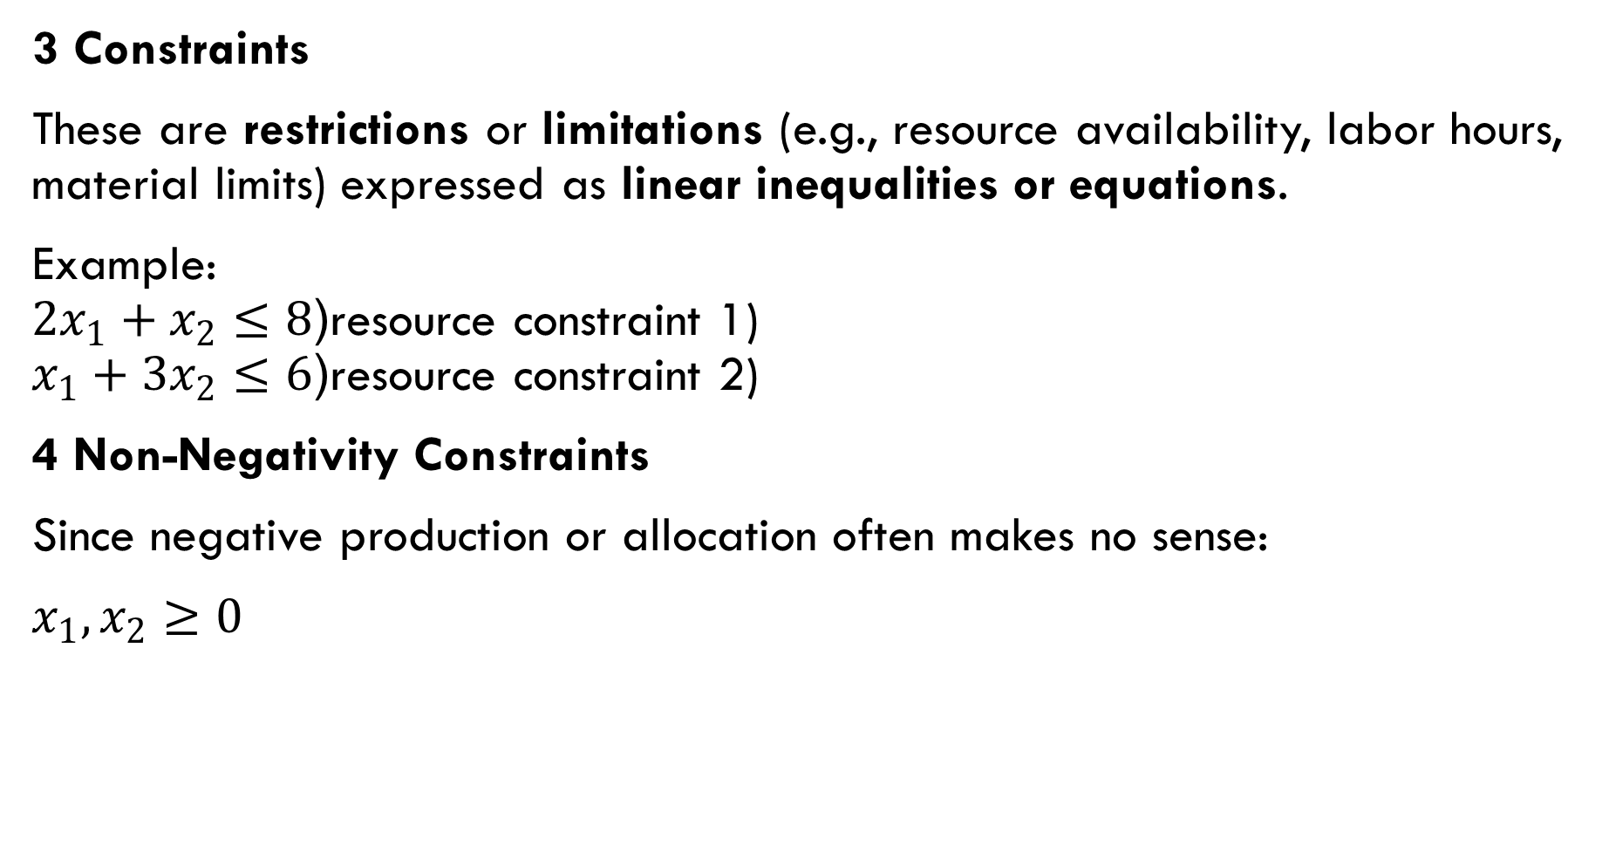
,
3 Constraints
These are restrictions or limitations (e.g., resource availability, labor hours, material limits) expressed as linear inequalities or equations.
Example:
$2x_{1}+x_{2}≤8$(resource constraint 1)
$x_{1}+3x_{2}≤6$(resource constraint 2)
4 Non-Negativity Constraints
Since negative production or allocation often makes no sense:
$x_{1},x_{2}≥0$

Slide 8
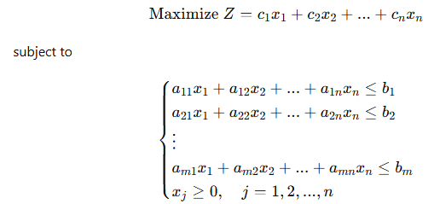
General Form of a Linear Programming Problem
1. Standard Form (Maximization type)

Slide 9
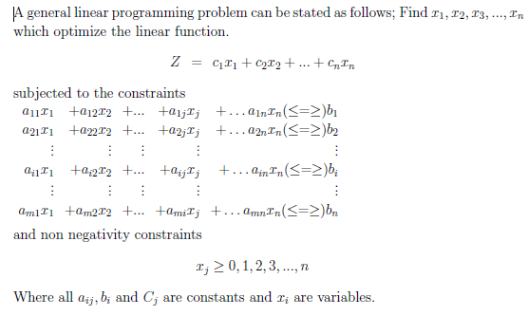
,

Slide 10
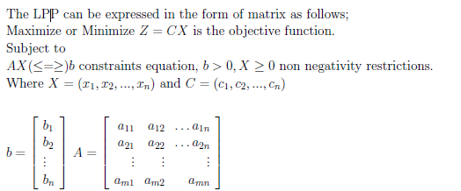
,
2. Matrix Form of LPP

Slide 11
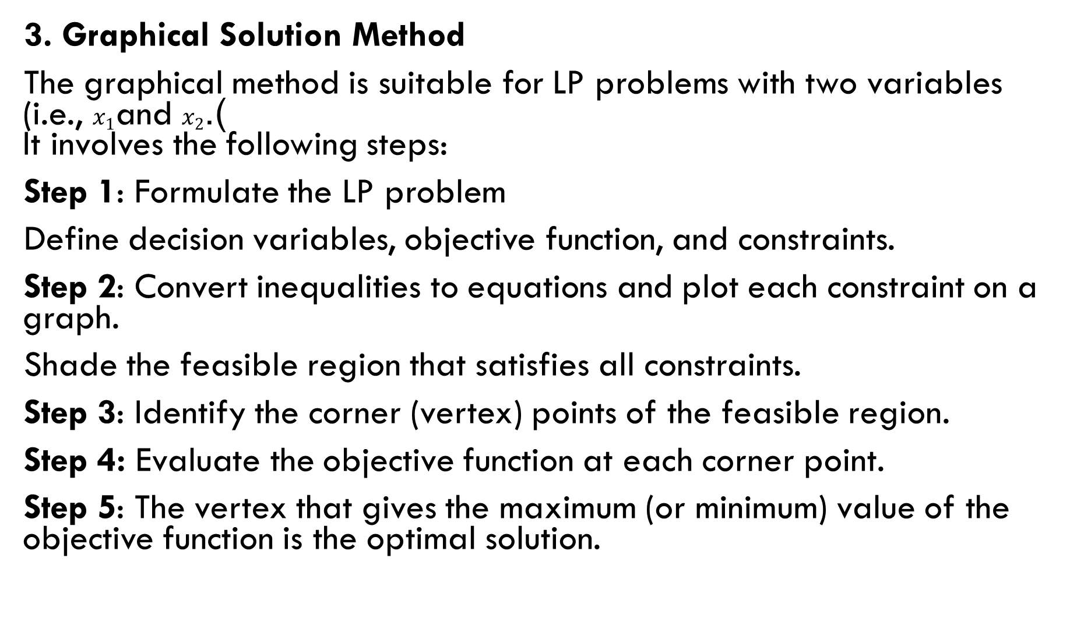
,
3. Graphical Solution Method
The graphical method is suitable for LP problems with two variables (i.e., $x_{1}$and $x_{2}$).
It involves the following steps:
Step 1: Formulate the LP problem
Define decision variables, objective function, and constraints.
Step 2: Convert inequalities to equations and plot each constraint on a graph.
Shade the feasible region that satisfies all constraints.
Step 3: Identify the corner (vertex) points of the feasible region.
Step 4: Evaluate the objective function at each corner point.
Step 5: The vertex that gives the maximum (or minimum) value of the objective function is the optimal solution.

Slide 12
Procedure for Formulation of LP Problems
Step 1. To write down the decision variables of the problem.
Step 2. To formulate the objective function to be optimized (Maximized os
Minimized) as a linear function of the decision variable.
Step 3. To formulate the other conditions of the problem such as resource
limitation, market constraints, interrelations between variables etc, as linear
equations in terms of decision variables.
Step 4. To add non negativity constraints from the considerations so that
the negative values of the decision variables do not have any valid physical
interpretation.
The objective function, the set of constraints and the non negative constraints together form a linear programming problem.

Slide 13
Examples 1
A resourceful home decorator manufactures two types of lamps says A and B.
Both lamps go through two technician’s first a cutter, second a finisher. Lamp A
requires 2 hrs of the cutter’s time and 1 hr of the finisher’s time. The cutter has
104 hrs and finisher has 76 hrs of available time each month. Profit per lamp A
is Tsh 600 and per B lamp is Tsh 1100. Assuming that he can sale all that he
produces, how many of each type of lamps should be manufactured to obtain the
best return.
Solution:
Formulation of the Mathematical Model of the Problem.
For the clear understanding of the problem, first we have to construct a table;

Slide 14

,
Decision Variables:
Let the decorator manufacture x1 and x2 lamps of type A and B respectively.
Objective Functions:
Therefore, the total profit (in Tsh) has to be maximized.
Max(z) = 6x1 + 11x2
Constraints
The manufacturer has limited time for manufacturing the lamp. There are 104 hrs available for cutting and 76 hrs available for finishing. Thus, total processing time is restricted.

Slide 15
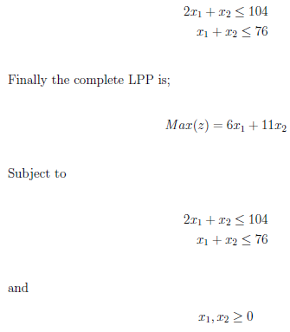
,
.

Slide 16
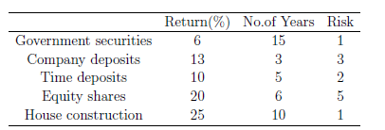
Example 2
Abdallah, a retired government officer, has recently received his retirement benefits, viz., provident fund, gratuity, etc. He is contemplating how much money he should invest in various alternatives open to him so as to maximize return on investment. The investment alternatives are Government securities, fixed deposits of a public limited company, equity shares, time deposits in a bank, and house construction. He has made a subjective estimate of the risk involved on a five-point scale. The data on the return on investment, the number of years for which the funds will be blocked to earn this return on investment and the subjective risk involved are as follows;

Slide 17
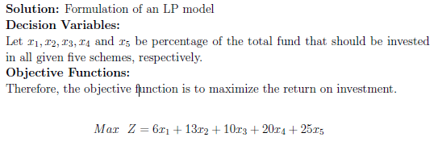
.
He was wondering as to what percentage of funds he should invest in each alternative
so as to maximize the return on investment. He decided that the risk
should not be more than 4, and funds should not be locked up for more than 15
years. He would necessarily invest at least 25% in house construction. Formulate
this problem as an LP model.

Slide 18
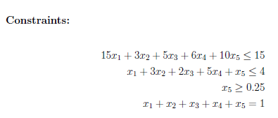
,

Slide 19



